Slide 1

AIRLINE DATA ANALYTICS FOR ENHANCED OPERATIONAL EFFICIENCY
22MCA009 | 22MCA021 | 22MCA037
BHUMIK RATHOD | HEMANG DEVALIYA | TIRTH MODI

Slide 2
Contents
Introduction
Importance of Airline Data Analytics
Apache Spark Overview
Spark's Role in Airline Data Analytics
Comparison Between Hadoop and Spark
Apache Spark Ecosystem
Work Flow of Airline Data Analytics
Key Challenges in Analyzing Airline Data
Spark's Data Processing Capabilities
Real-Time Analytics with Spark
Case Study: Airline Operational Efficiency
Data Processing Comparison
Spark Streaming for Flight Monitoring
Data Visualization with Spark
Spark Ecosystem and Integration
Security and Scalability Considerations
Spark Performance Optimization
Best Practices for Spark Implementation
Future Trends in Airline Data Analytics
Implementation Process
Conclusion

Slide 3

Introduction
Welcome to the presentation on Unleashing the Power of Apache Spark: Harnessing Airline Data Analytics for Enhanced Operational Efficiency. In this session, we will explore how Apache Spark can revolutionize the way airlines analyze their data to optimize operations and improve efficiency.

Slide 4

Importance of Airline Data Analytics
Airline industry generates massive amounts of data related to flights, passengers, operations, and more. Analyzing this data can provide valuable insights to enhance operational efficiency, improve customer experience, and optimize resource allocation. Data analytics is crucial for airlines to stay competitive and make data-driven decisions

Slide 5

Apache Spark Overview
Apache Spark is an opensource distributed computing system that provides a unified analytics engine for big data processing. It offers highspeed data processing, in memory caching, fault tolerance, and support for various programming languages. Spark's versatility and scalability make it an ideal choice for analyzing large volumes of airline data.

Slide 6
Spark's Role in Airline Data Analytics
Apache Spark plays a crucial role in airline data analytics by enabling fast and efficient processing of diverse data sources. It empowers airlines to perform real-time analytics, predictive analysis, and data visualization, leading to improved decision making, proactive maintenance, and enhanced operational efficiency across various departments

Slide 7
Comparison between Hadoop & Spark
Data Processing Paradigm
Data Processing Speed(Map Reduce | In Memory)
Ease of Use(Java | Python, Scala, SQL, etc)
Fault Tolerance(Replication)
Ecosystem
Data Caching(DISK | Memory)
Resource Management(YARN | Built-in Cluster)

Slide 8
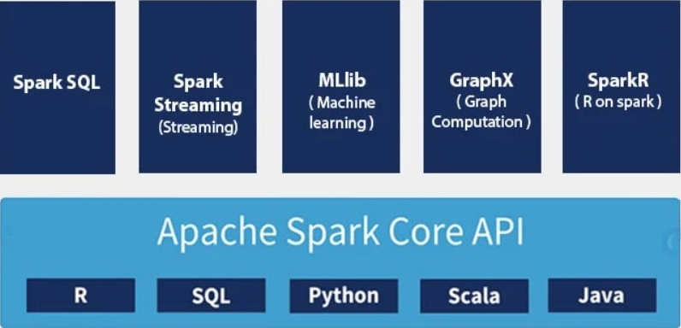
APACH SPARK ECOSYSTEM

Slide 9
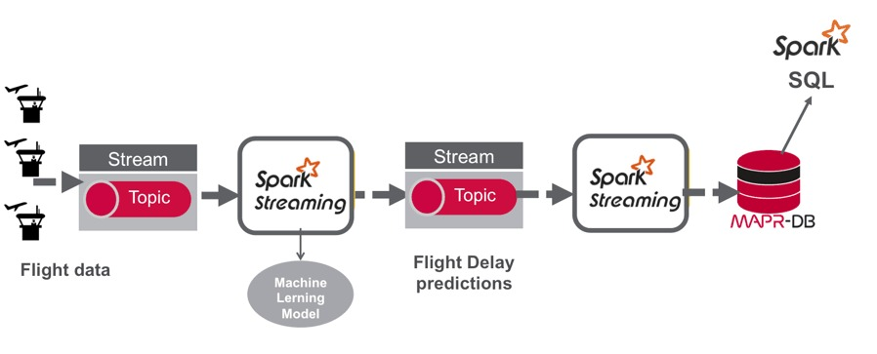
Work Flow of Airline Data Analytics

Slide 10
Key Challenges in Analyzing Airline Data
Analyzing airline data presents several challenges, including data volume, variety, velocity, and veracity. Airlines deal with massive volumes of structured and unstructured data from multiple sources, such as flight records, customer feedback, weather data, and social media. Apache Spark helps overcome these challenges by providing distributed computing capabilities and advanced data processing techniques.

Slide 11
Spark's Data Processing Capabilities
Apache Spark offers a wide range of data processing capabilities, including batch processing, streaming, SQL queries, and machine learning. It can handle structured, semi-structured, and unstructured data, enabling airlines to extract valuable insights from various data formats and perform complex data transformations efficiently.

Slide 12
Real-Time Analytics with Spark
Real-time analytics is crucial for airlines to monitor flight operations, detect anomalies, and make timely decisions. Apache Spark's streaming capabilities enable airlines to process and analyze data in real-time, providing instant insights for proactive measures, such as predicting delays, optimizing crew allocation, and ensuring passenger satisfaction.

Slide 13
Case Study: Airline Operational Efficiency
In this case study, we will explore how a major airline improved operational efficiency using Apache Spark. By analyzing historical flight data, crew schedules, and maintenance records, they were able to identify optimization opportunities, streamline operations, reduce delays, and enhance customer satisfaction. This case study demonstrates the tangible benefits of leveraging Spark in airline data analytics

Slide 14
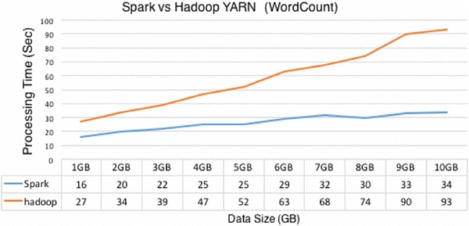
Data Processing Comparison

Slide 15
Spark Streaming for Flight Monitoring
Flight monitoring requires real-time analysis of data from various sources, such as radar data, weather updates, and flight status information. Apache Spark's streaming capabilities enable airlines to process and analyze this data in near real-time, allowing for proactive decision-making, air traffic management, and improved flight safety.

Slide 16
Data Visualization with Spark
Effective data visualization is essential for airlines to gain actionable insights from complex data. Apache Spark's integration with visualization libraries, such as Matplotlib and D3.js, enables airlines to create interactive and visually appealing dashboards, charts, and graphs. This facilitates better understanding of data patterns, trends, and anomalies.

Slide 17
Spark Ecosystem and Integration
Apache Spark has a rich ecosystem of tools and frameworks that enhance its capabilities. It seamlessly integrates with popular big data technologies like Hadoop, Kafka, and Cassandra, enabling airlines to leverage existing infrastructure and data sources. This integration ensures a comprehensive and efficient data analytics ecosystem for airlines.

Slide 18
Security and Scalability Considerations
As airlines deal with sensitive data, ensuring data security is crucial. Apache Spark provides robust security features, including encryption, access controls, and auditing, to protect sensitive information. Additionally, Spark's scalability allows airlines to handle growing data volumes and accommodate future data analytics needs without compromising performance or security.

Slide 19
Spark Performance Optimization
To achieve optimal performance with Apache Spark, airlines can employ various techniques, such as partitioning, caching, and cluster optimization. By fine-tuning Spark configurations, leveraging memory caching, and optimizing cluster resources, airlines can significantly improve data processing speed and overall performance of their analytics workflows.

Slide 20
Best Practices for Spark Implementation
Implementing Apache Spark effectively requires adherence to best practices. Some key considerations include data preparation, choosing the right Spark components, monitoring performance, and maintaining code quality. By following these best practices, airlines can maximize the benefits of Spark and ensure successful implementation of their data analytics initiatives.

Slide 21
Future Trends in Airline Data Analytics
Airline data analytics is an evolving field, and several trends are shaping its future. These include AI-powered analytics, Internet of Things (IoT) integration, edge computing, and enhanced data visualization. By embracing these trends and leveraging Apache Spark's capabilities, airlines can stay ahead of the curve and unlock new opportunities for operational excellence.

Slide 22
IMPLEMENTATION PROCESS

Slide 23
Airline DATASET
This dataset is a record of 3.5 Million+ US Domestic Flights from 1990 to 2009. It has been taken from OpenFlights website which have a huge database of different travelling mediums across the globe.

Slide 24
Dataset fields
Origin_airport: Three letter airport code of the origin airport
Destination_airport: Three letter airport code of the destination airport
Origin_city: Origin city name
Destination_city: Destination city name
Passengers: Number of passengers transported from origin to destination
Seats: Number of seats available on flights from origin to destination
Flights: Number of flights between origin and destination (multiple records for one month, many with flights > 1)
Distance: Distance (to nearest mile) flown between origin and destination
Fly_date: The date (yyyymm) of flight
Origin_population: Origin city's population as reported by US Census
Destination_population: Destination city's population as reported by US Census

Slide 25
Apache Spark airline data analysis
Procedure
Step-1 Installing and Initializing Spark on Google Colab
Step-2 Set up Java Home and Spark Home path in environment.
Step-3 Install pyspark
Step-4 create Spark Session
Step-5 Import dataset
Step-6 Use Spark Sql query
Step-7 Visualize the Data

Slide 26

Step-1 Installing and Initializing Spark on Google Colab

Slide 27

Step-2 Set up Java Home and Spark Home path in environment.

Slide 28
Step-3 Install pyspark

Slide 29

Step-4 create Spark Session

Slide 30
Step-5 import dataset

Slide 31
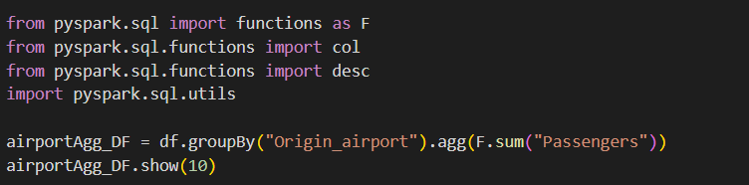
Step-6 Use Spark Sql query

Slide 32
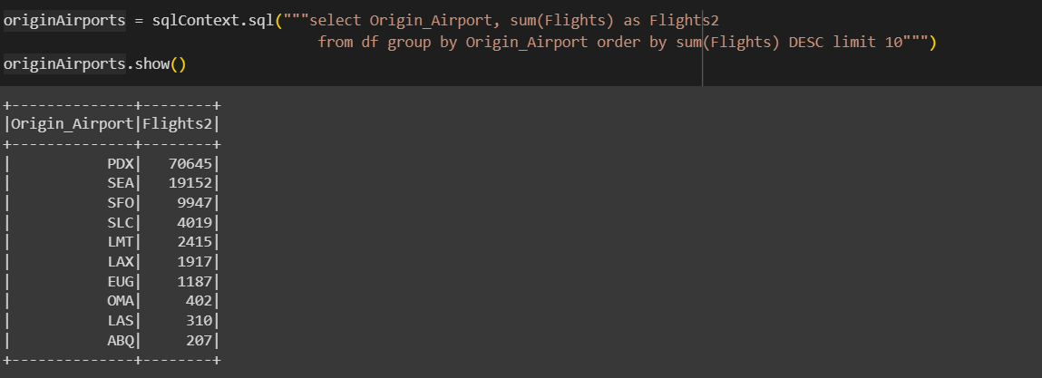
Highest Flight Departures Airport

Slide 33
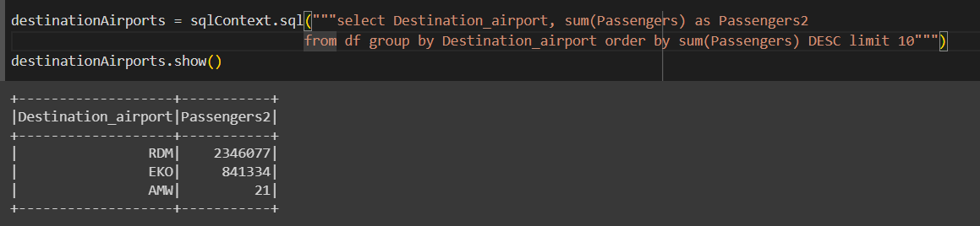
Highest Passenger Arrival Airport

Slide 34
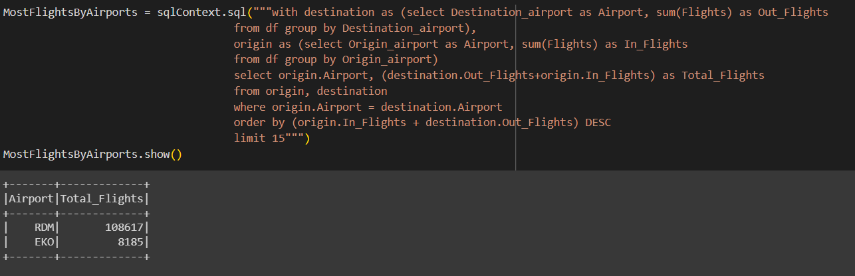
Airports with Most Flights

Slide 35
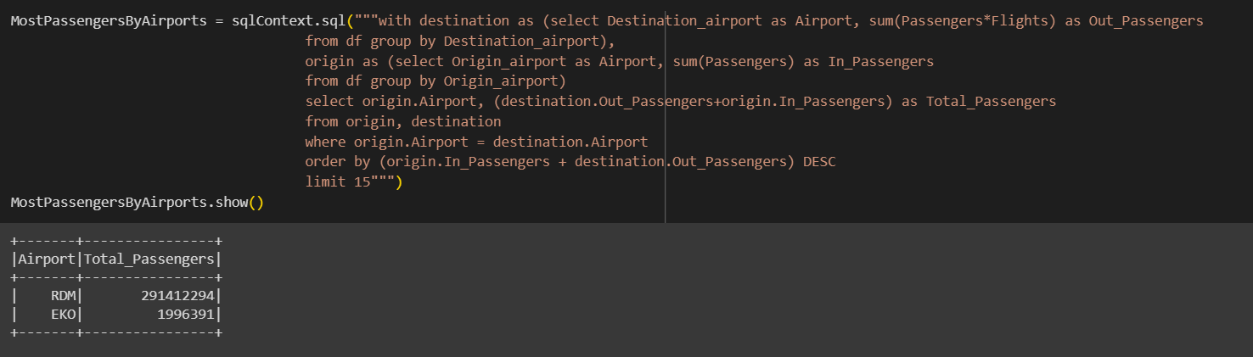
Airports with Most Passengers

Slide 36
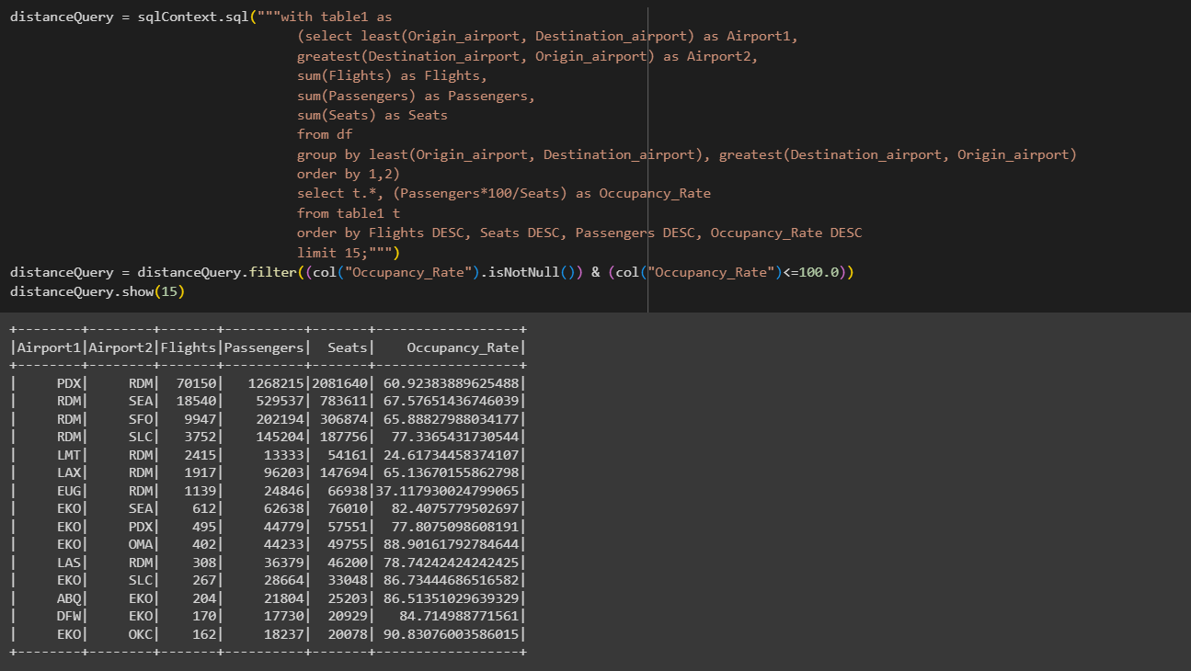
Occupancy Rates for Routes with Most Flights

Slide 37
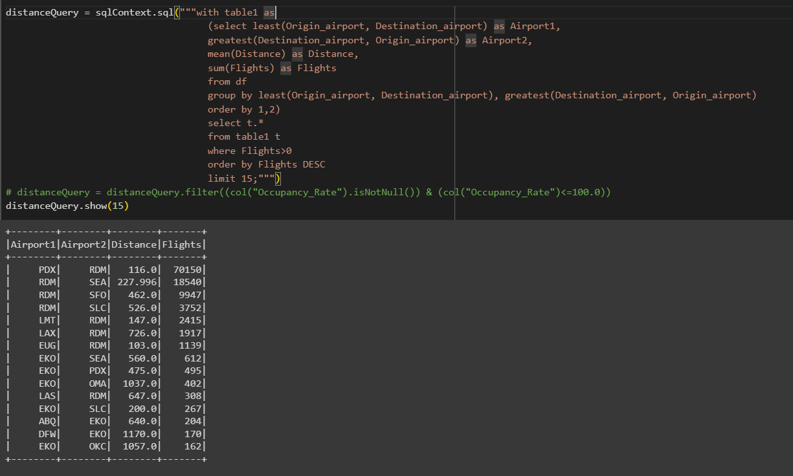
Number of Flights vs Distance

Slide 38
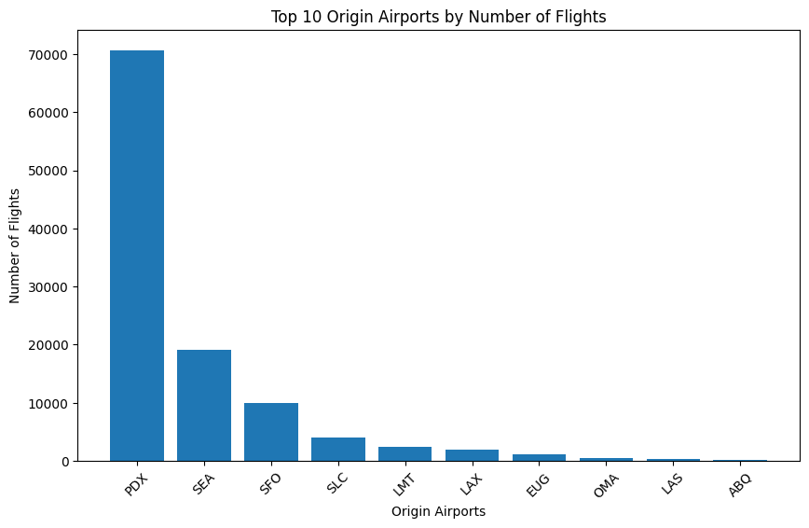
Data Visualization

Slide 39
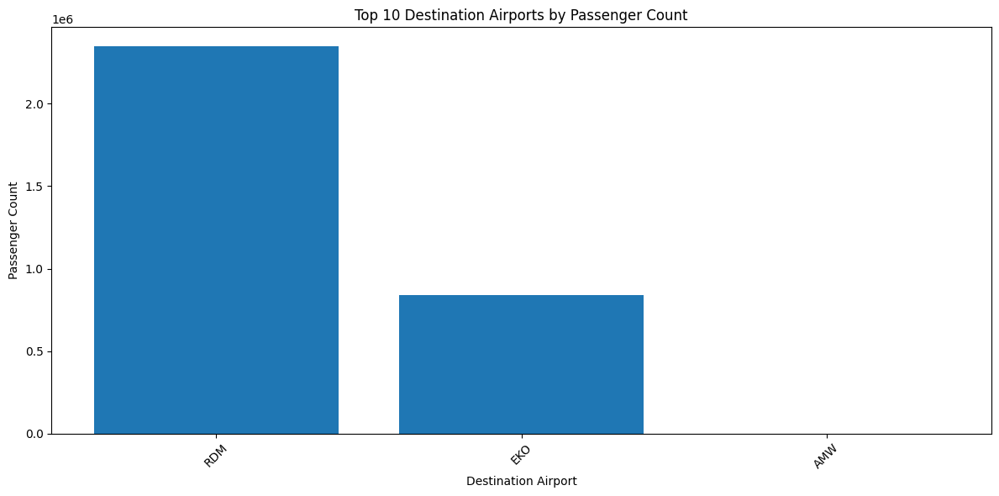
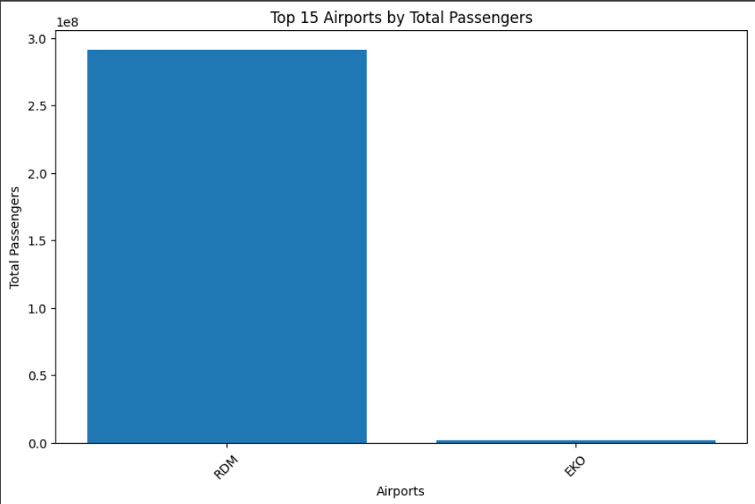

Slide 40
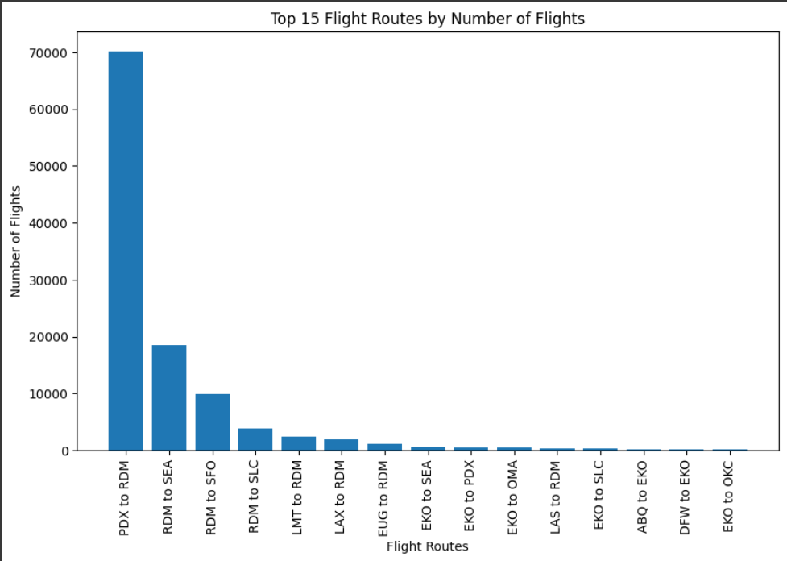

Slide 41
Conclusion
In conclusion, Apache Spark is a game-changer for airline data analytics, empowering airlines to unlock the potential of their data for enhanced operational efficiency. By leveraging Spark's capabilities in real-time analytics, machine learning, and data visualization, airlines can make data-driven decisions, optimize resources, and improve customer experience. Embracing Spark ensures a competitive edge in the dynamic aviation industry.

Slide 42
THANK YOU

